Slide 1
CSS
MCNDHS
Ms. Eng

Slide 2
AIM: HOW DO WE DEFINE CLASSES?
Do now:
Daily Grade:
On-time/attendance/not leaving the classroom: 25%
Cellphones: 25%
Notes:25%
Classwork/Homework: 25%

Slide 3


BEFORE:
We focused on ID’s

Slide 4
DISADVANTAGES:
What if we want to use a SPECIFIC effect to an element within our ID?
ID’s affect the ENTIRE element

Slide 5
CLASSES:
html:
type out element, followed by class=“ “.
example:
<div class=“hello”>
<p class=“hello”>sldjfskljfkdls</p>
</div>
css:
to affect everything:
.hello{
}
to affect certain items:
p.hello{
}

Slide 6
VERY IMPORTANT
You can ONLY target INLINE elements.
If you want to change block elements, don’t mention the class.

Slide 7
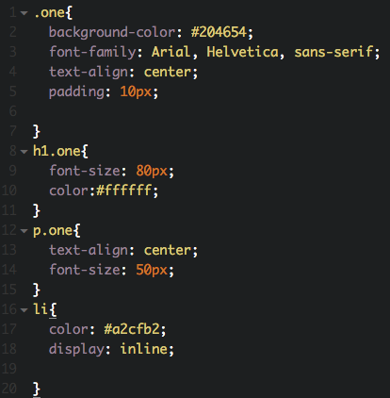
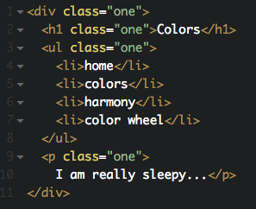
EXAMPLE:

Slide 8

ACTIVITY:

